Slide 1

HOW TO WIN THE STANLEY CUP
BY: Tyler Kuchan

Slide 2
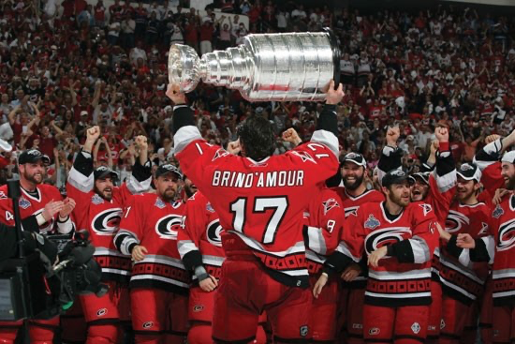
Project Overview
Question:
What factors in the regular season contribute to NHL teams not only making the playoffs, but also being able to win the Stanley Cup?
Observing the Salary Cap Era
(2006-PRESENT)

Slide 3
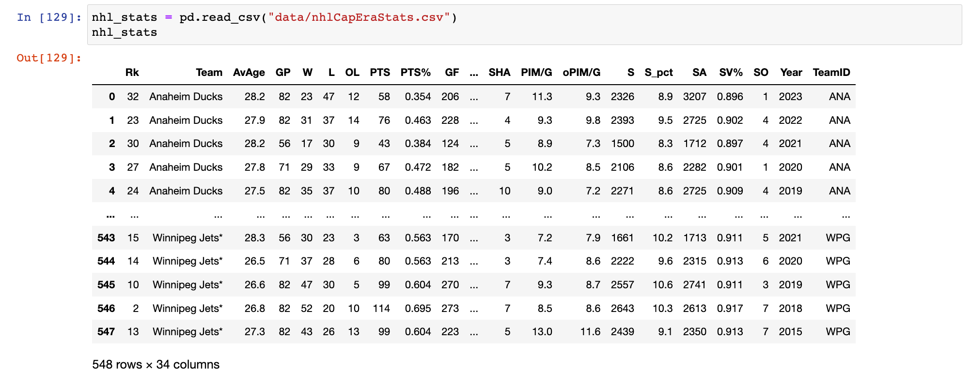
Cleaning the Data
* all data gathered from Hockey Reference

Slide 4
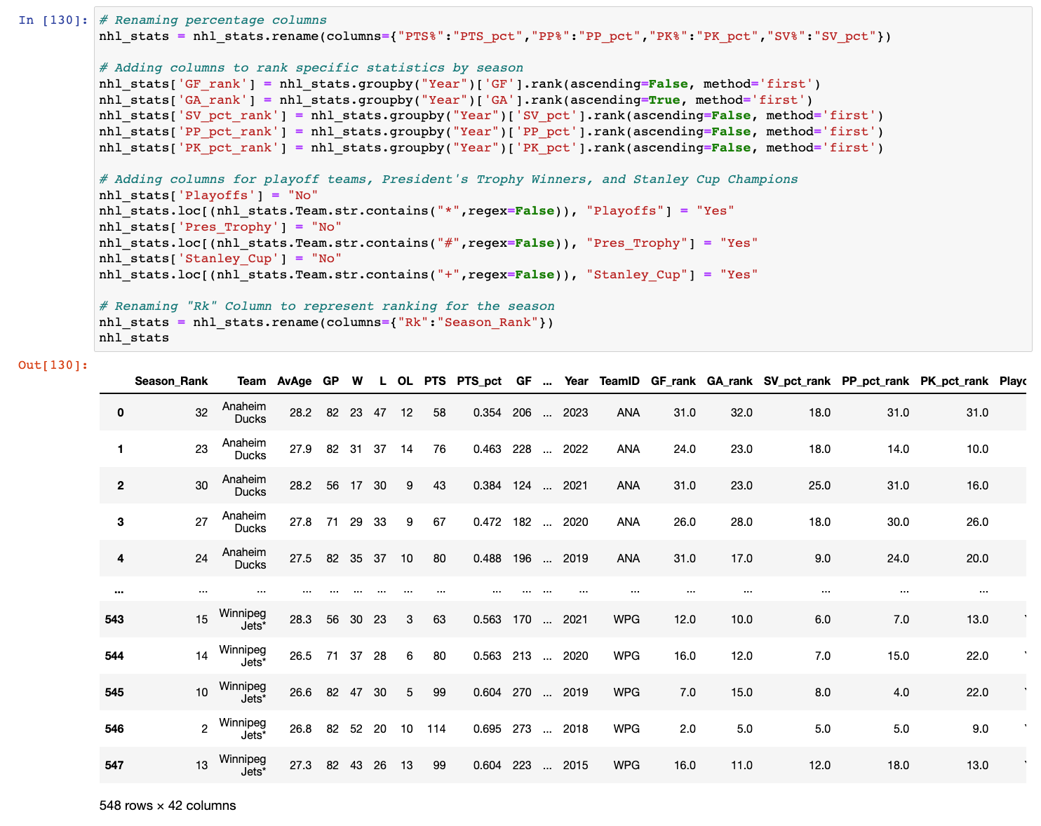
Renamed columns with non-letters in names.
Ranked teams in each season in 5 categories:
Goals for
Goals Allowed
Save Percentage
Power Play Percentage
Penalty Kill Percentage
Created three columns based on footnotes from Hockey Reference
* = Made Playoffs
# = President’s Trophy
+ = Stanley Cup Champions
Renamed “Rk” to “Season_Rank”

Slide 5
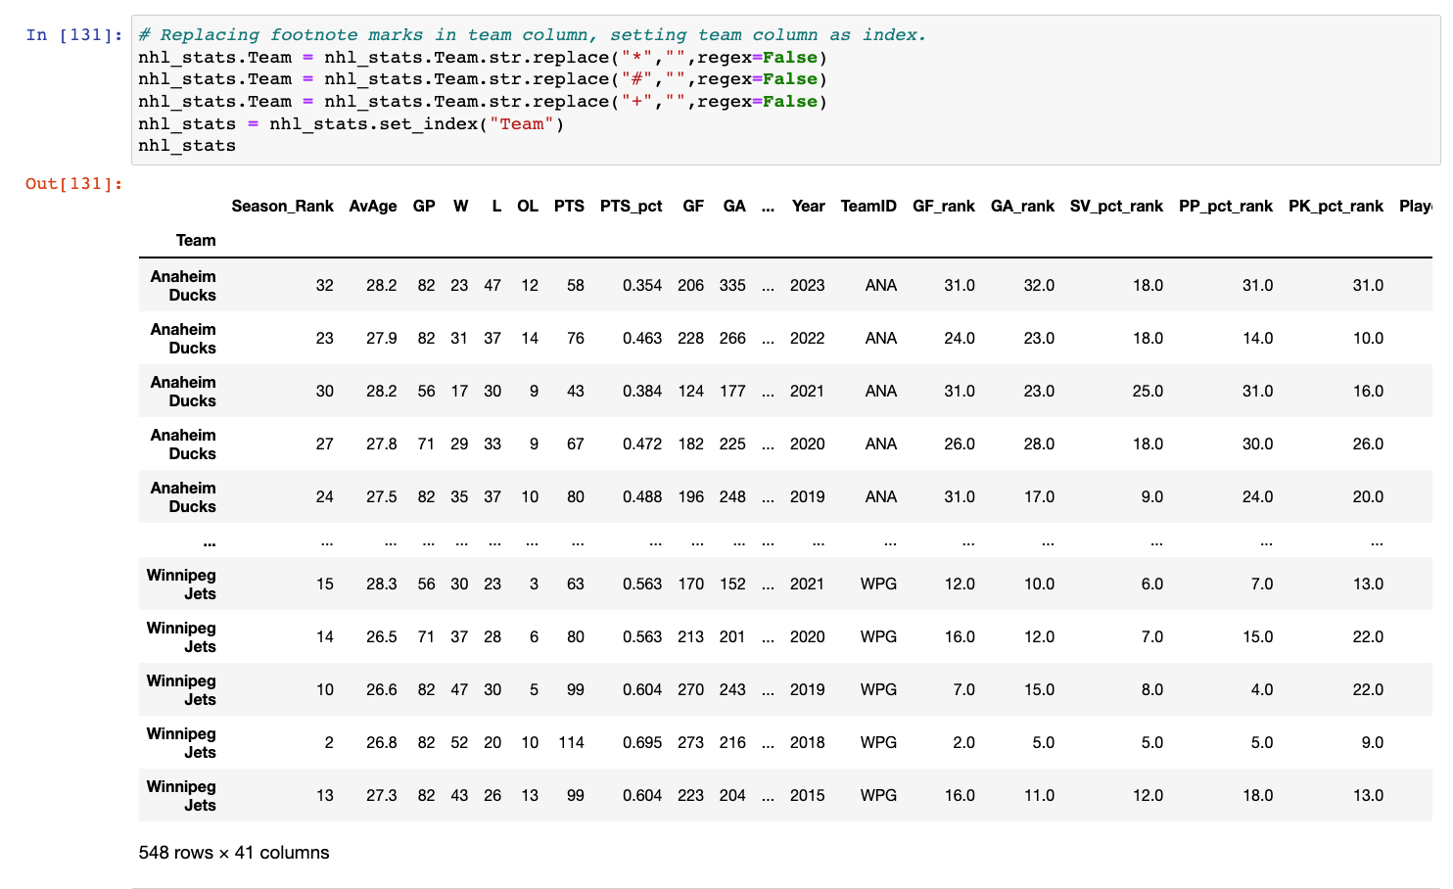

Slide 6
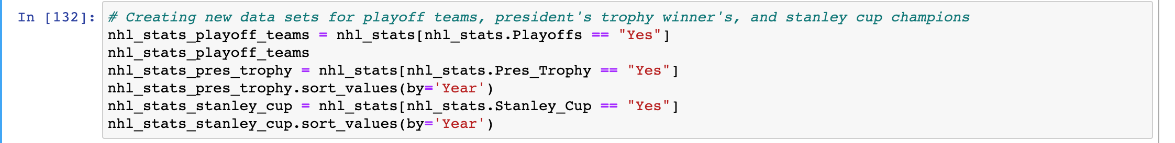
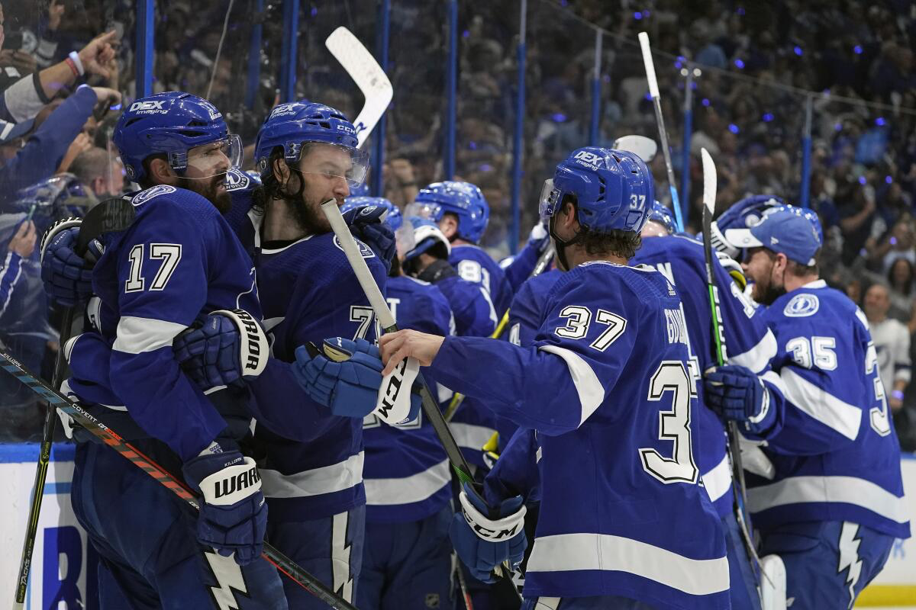


Created New Data Frames
Made Playoffs
President’s Trophy
Stanley Cup

Slide 7
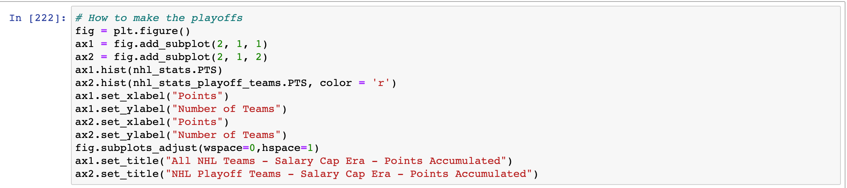
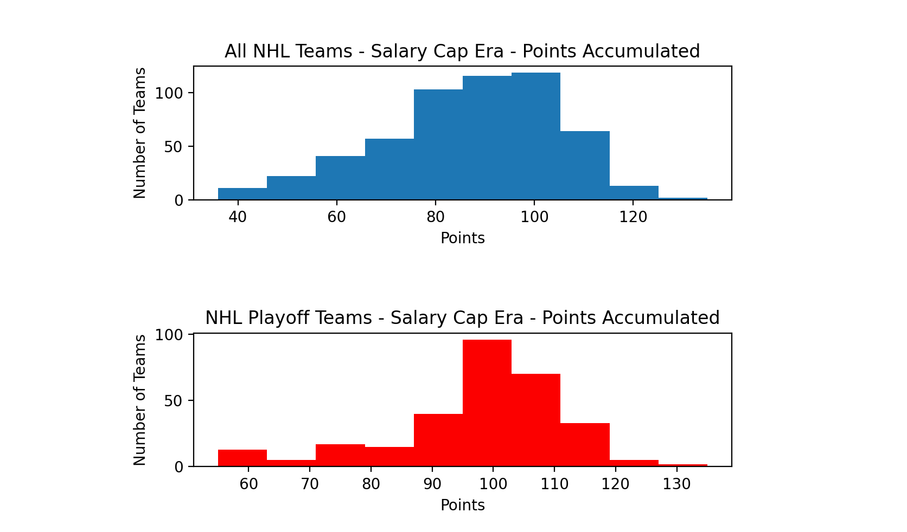
What does it take to make the Playoffs?
Used histograms to look at team points accumulated throughout the season.
Most Playoff teams accumulate right around 100 points throughout the year.
Playoff data has a large left skewed tail.

Slide 8
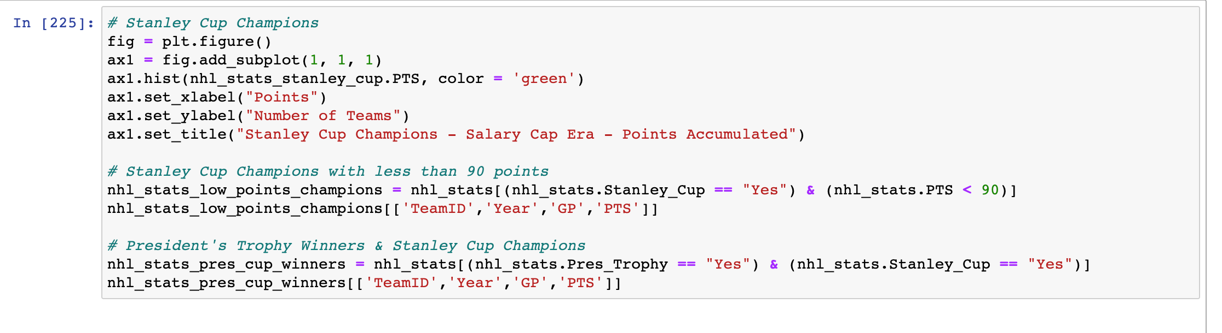
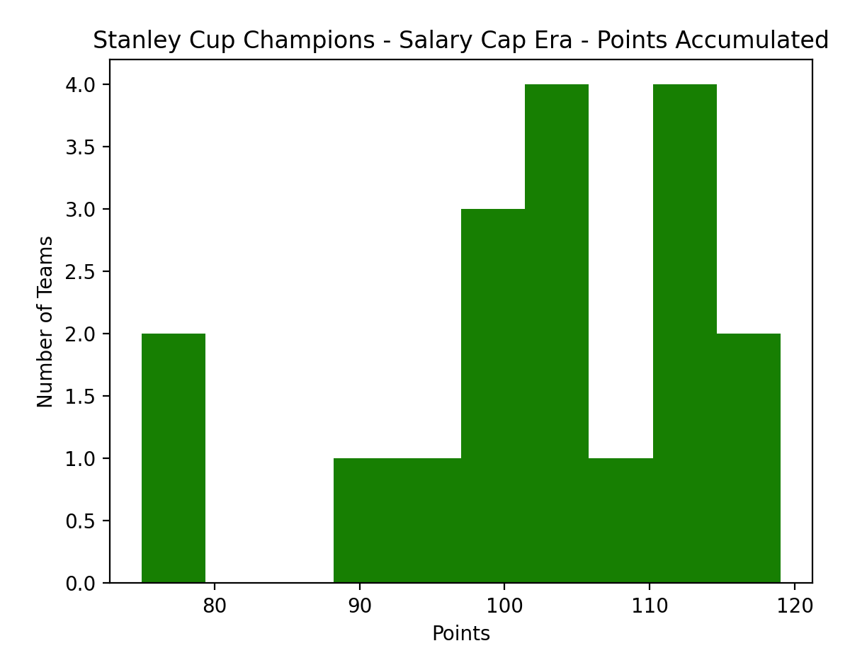
“WE WANT
THE CUP!”
Histogram used to observe the regular season points accumulated by the Stanley Cup Champions of each season.
89 percent of the champions in the Salary Cap Era earned at least 90 points.
66 percent earned at least 100 points
Similar left skew to the Playoff teams’ histogram.

Slide 9
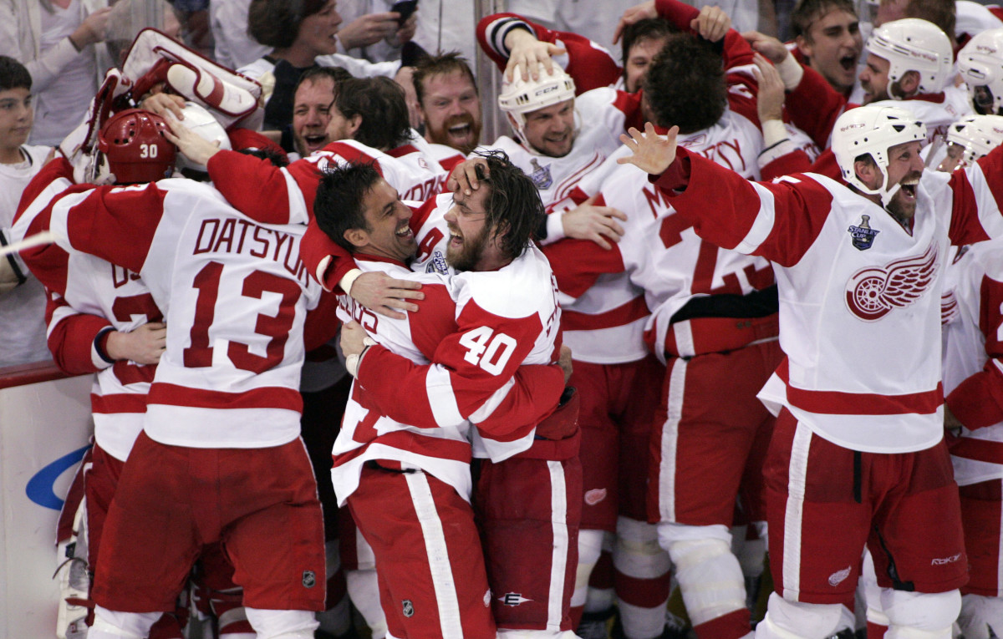
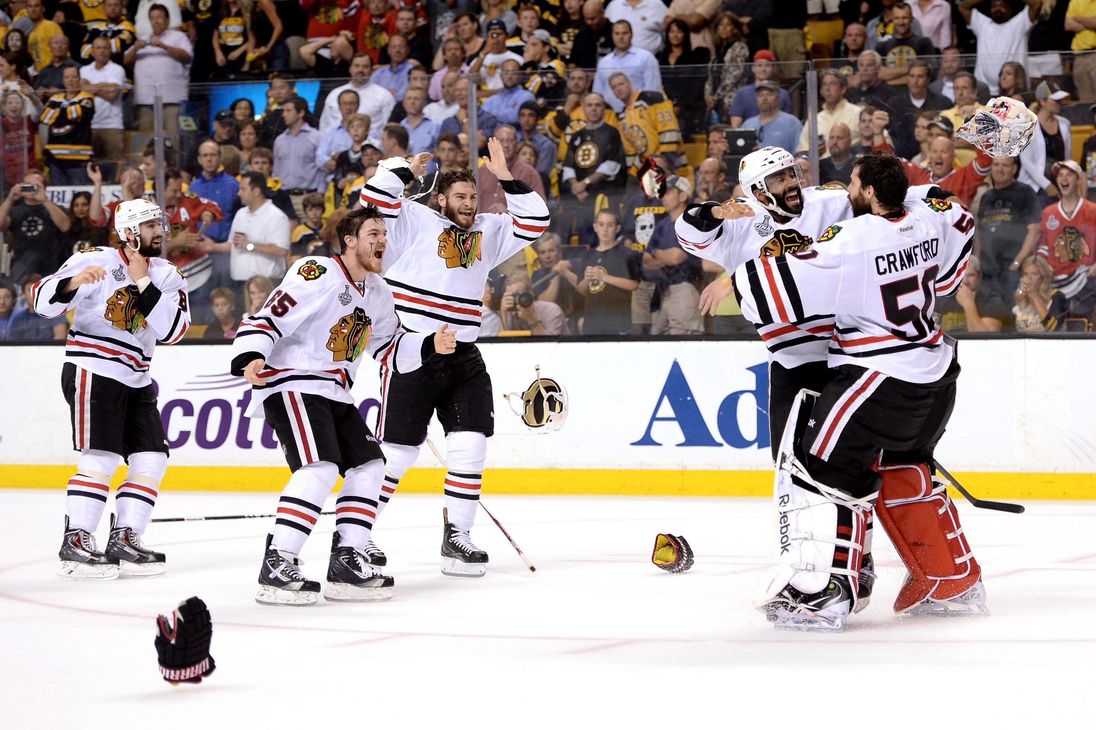

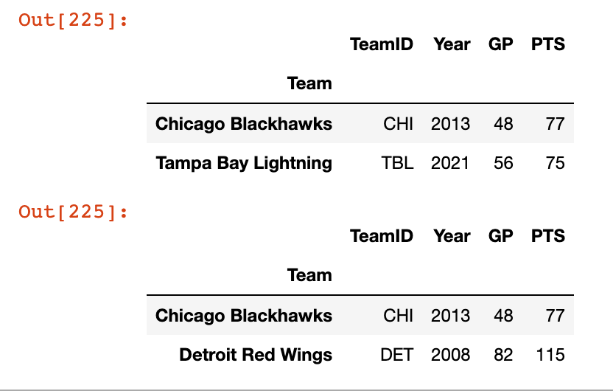
Outliers & the President’s Trophy Curse
2 of the 18 Salary Cap Era Champions accumulated less than 80 points
2013 Chicago Blackhawks
2021 Tampa Bay Lightning
2 of the 18 Salary Cap Era Champions also won the President’s Trophy
2008 Detroit Red Wings
2013 Chicago Blackhawks

Slide 10
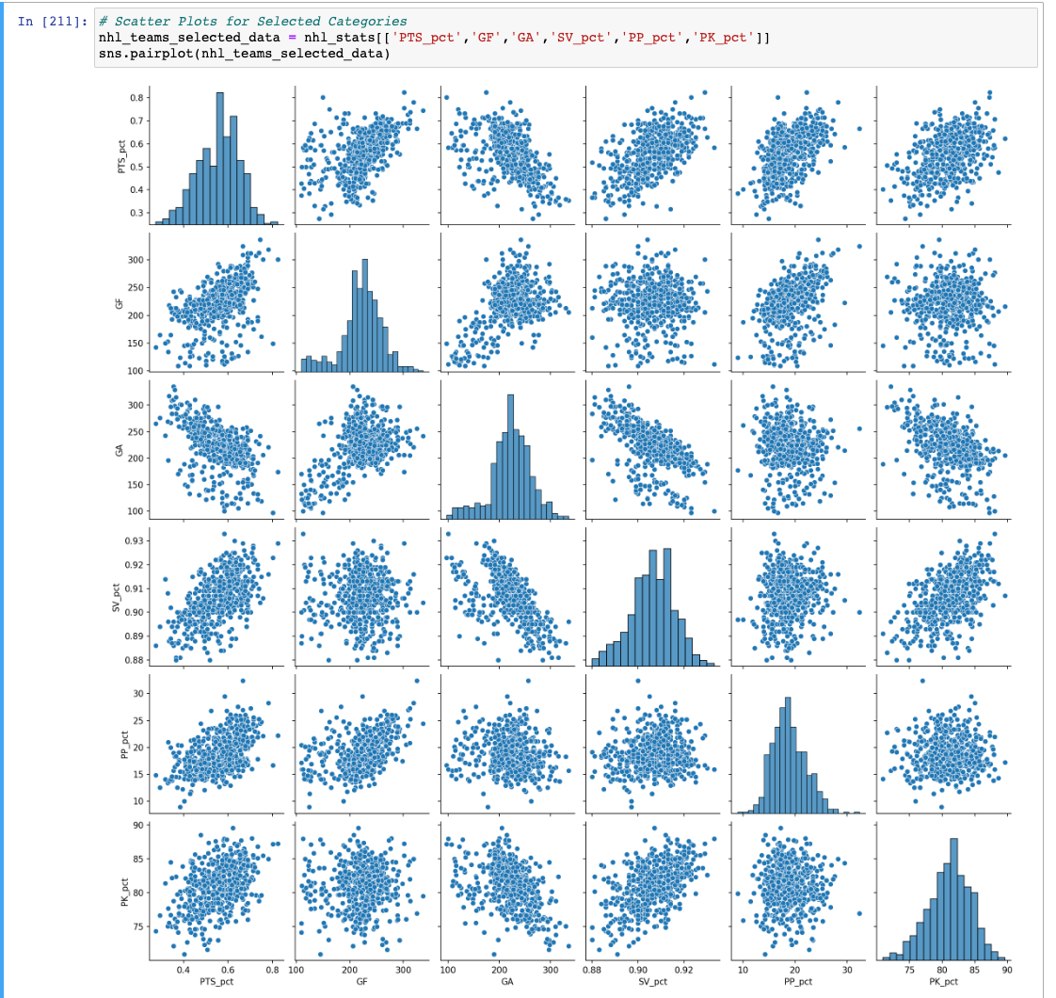
How to win games in the NHL?
Goals For
Goals Allowed
Save Percentage
Power Play Percentage
Penalty Kill Percentage
Additionally, independent variable changed from Points to Points Percentage to account for shortened seasons in 2013, 2020, and 2021.

Slide 11
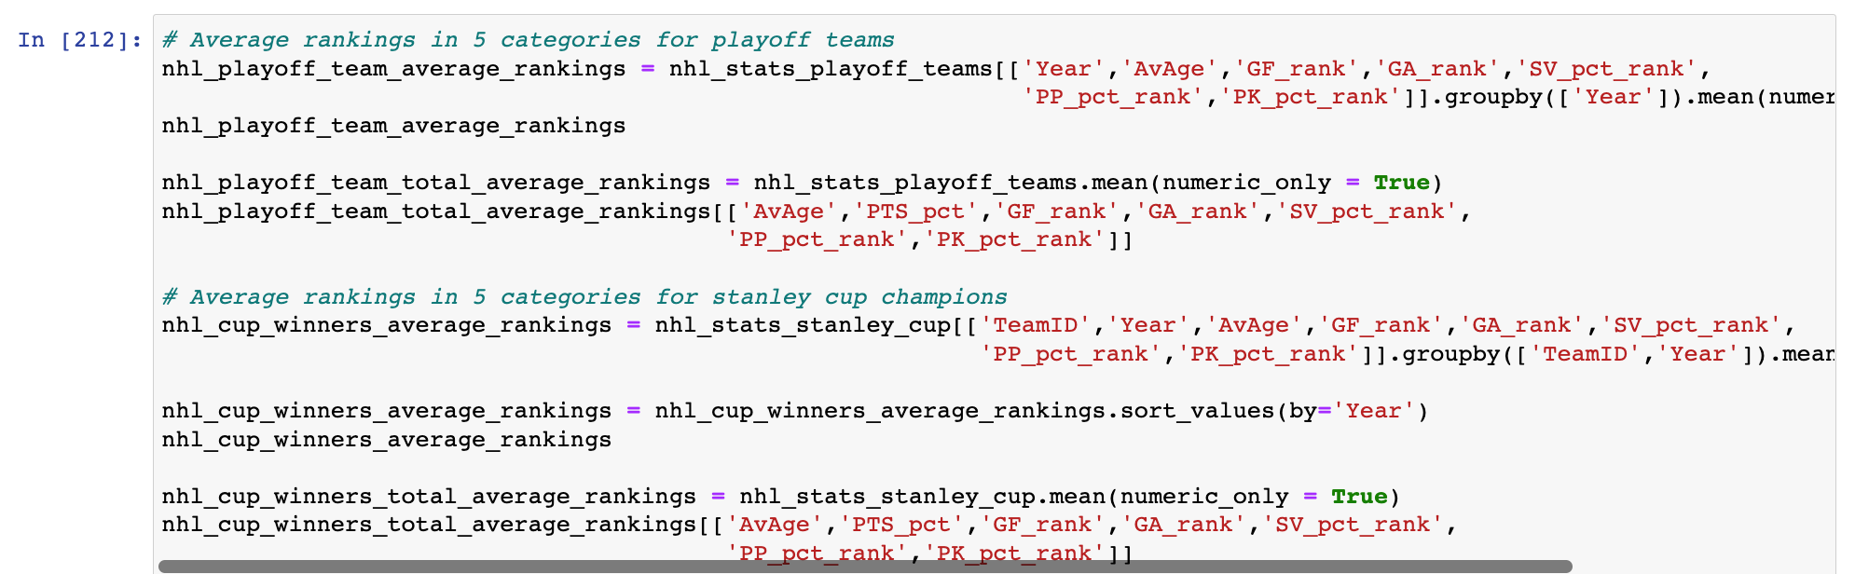
Average Rankings
Made new data frames to observe the average rankings of playoff teams in each statistic for each season, as well as the Stanley Cup Champions of each season.

Slide 12
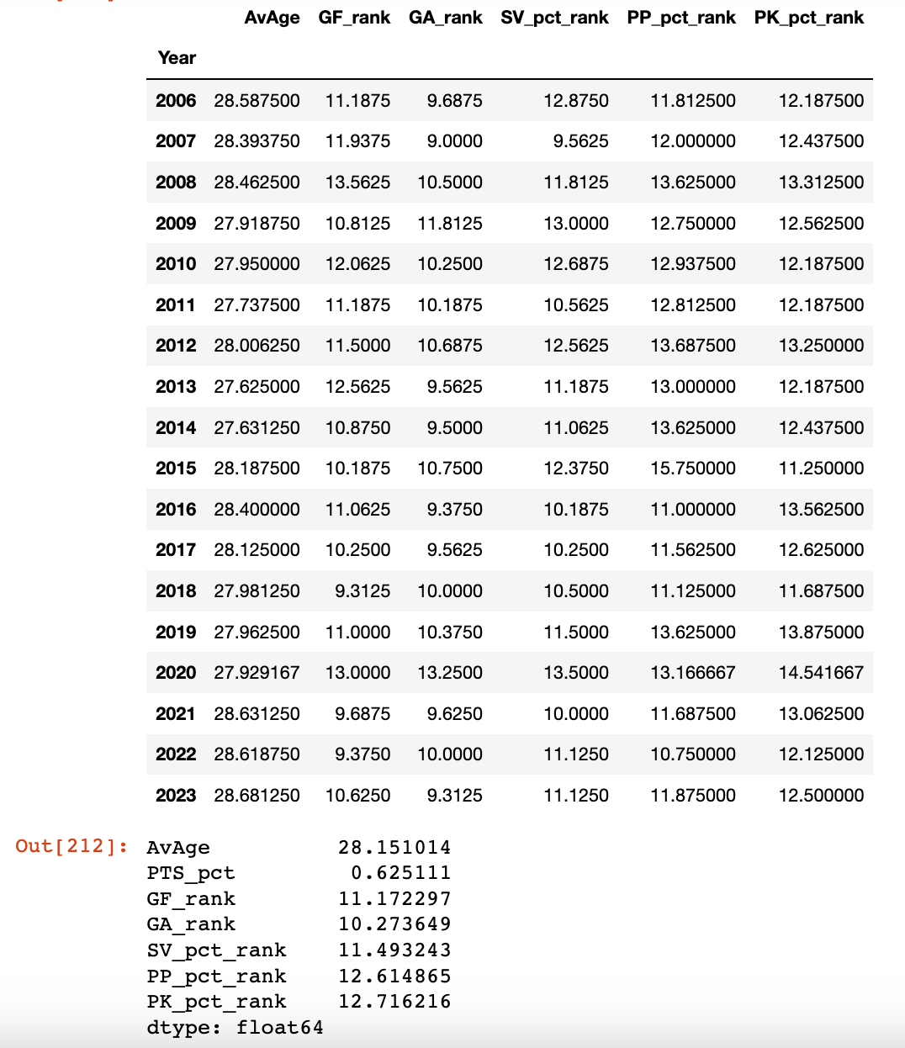
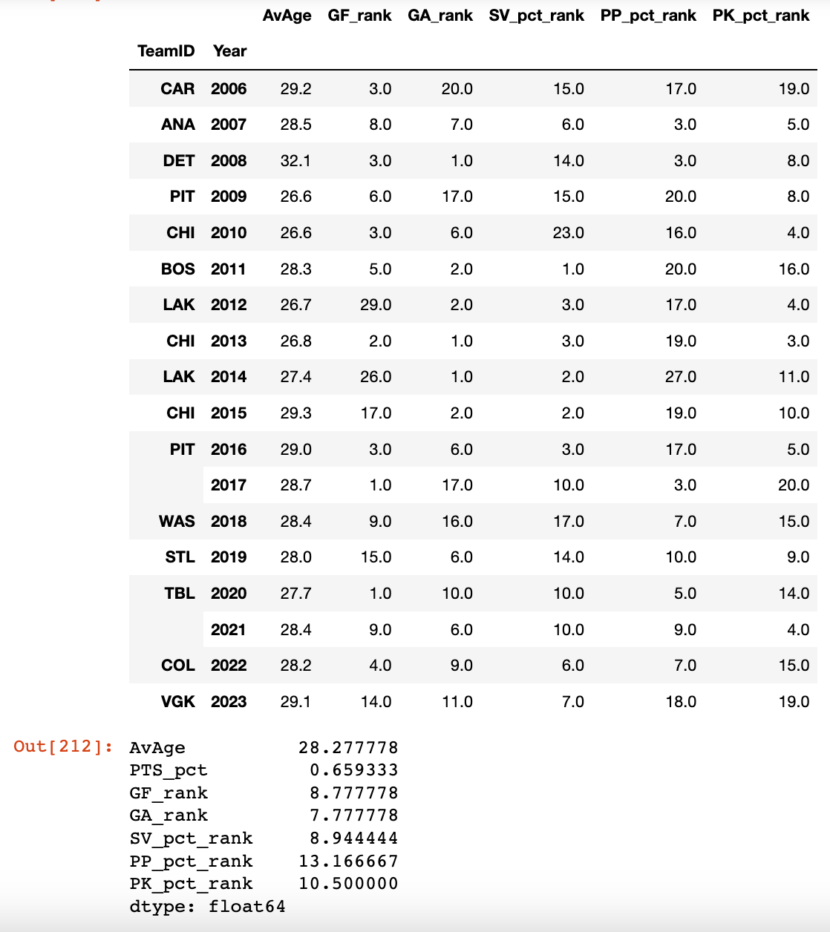
All 18 Champions were Top 10 in at least 1 category.
Power Play percentage lower for champions than average playoff teams.

Slide 13
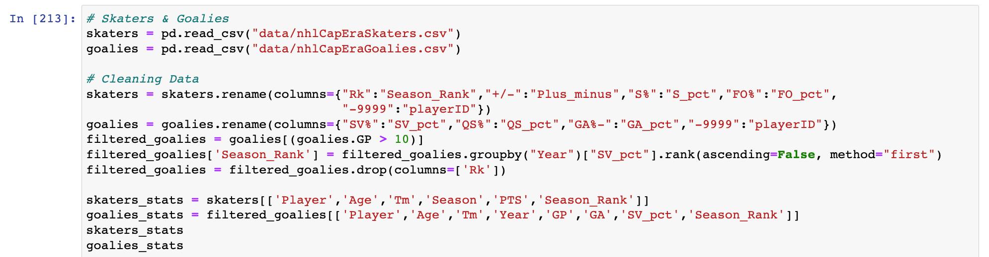
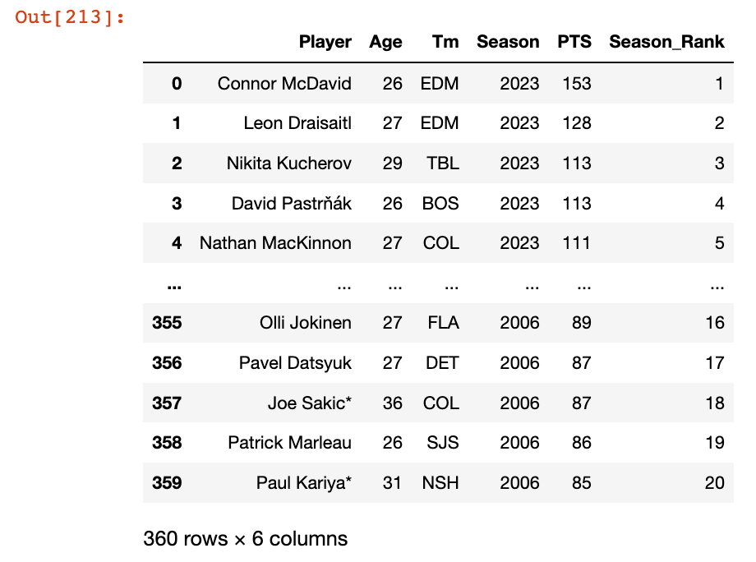
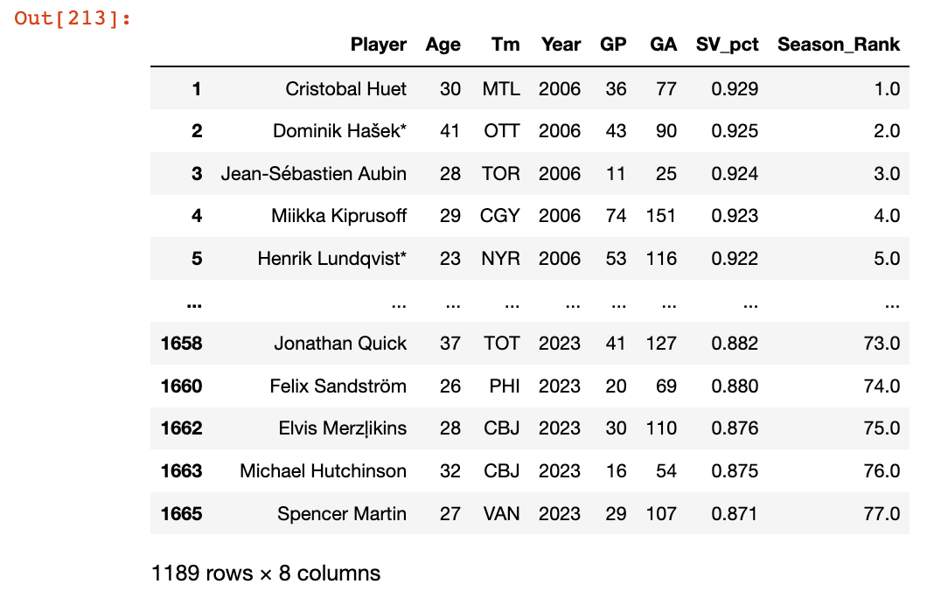
Skaters & Goalies
Imported new files to observe individual skaters & goalies.
Filtered Skaters’ statistics to points (goals + assists) and how they ranked for that season.
Filtered Goalies’ statistics to games played, goals allowed, save percentage, and how they ranked in save percentage for that season.

Slide 14
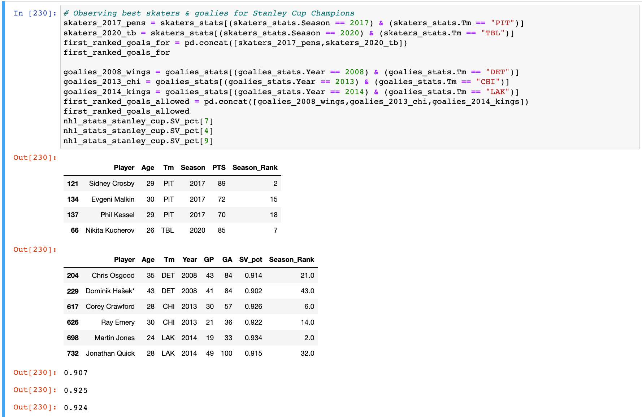

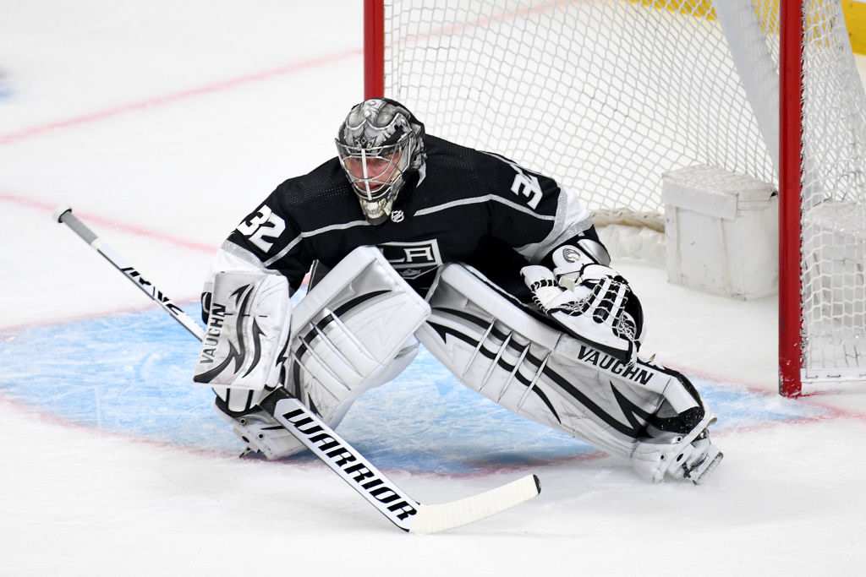
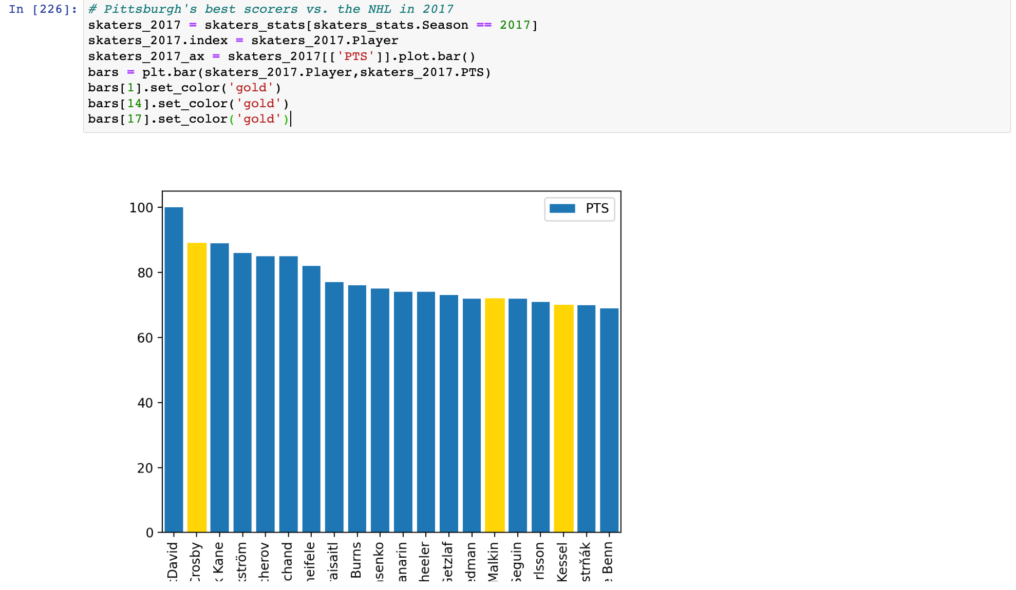
Impact Players
Observed teams ranked #1 in goals for, and #1 in goals allowed.
Looked directly at Pittsburgh’s 2017 championship team, which had 3 players in the top 20 for points in that season.

Slide 15


Conclusion
To make the playoffs in the NHL, 100+ points will get you in, with 90+ points being on the shaky side.
To win the Stanley Cup, a team needs to be in the Top 10 in the NHL in Goals For, Goals Allowed, Save Percentage, Power Play Percentage, and/or Penalty Kill Percentage.
Having an impact player doesn’t hurt, but it doesn’t make it impossible to win.

